Slide 1
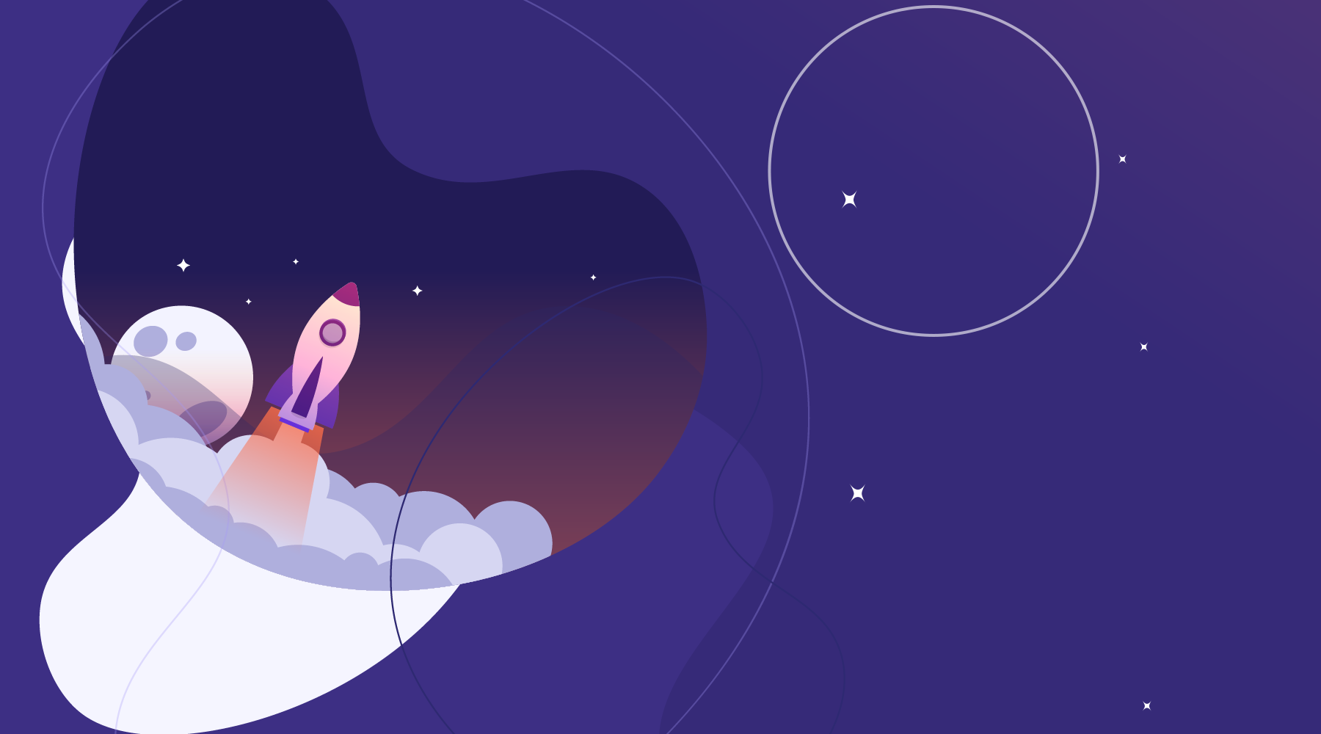
3D Solar System Interactive Animation
HTML - CSS

Slide 2
Project Launch
01
02
03
04
01
02
03
Thrilled to announce my latest frontend project
A visually dynamic 3D Solar System Simulation
Developed entirely using HTML and CSS
No JavaScript required
A visually dynamic 3D Solar System Simulation
Developed entirely using HTML and CSS

Slide 3
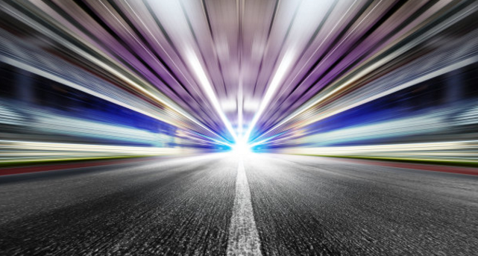
Overview
88%
Frontend Project Showcase
Built entirely with HTML & CSS — no JavaScript

Slide 4
About the Project
Core: Glowing Sun at the center
Planets revolving around the Sun
Includes Mercury, Venus, Earth, Jupiter, Saturn, Uranus, and more

Slide 5
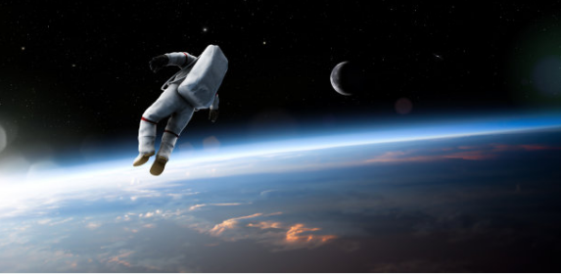
Unique Aspects – Part 1
🌍 Earth has its own Moon with nested orbit
🌀 Two rotating purple galaxies in the background
☄️ A dynamically animated falling star

Slide 6
Unique Aspects – Part 2
Dozens of twinkling stars simulate deep space
All built with pure CSS animations and gradients
Responsive design for desktop, tablet, and mobile

Slide 7
Key Features
Key Features
✅ Pure CSS Animations for orbits and motions
🌍 Realistic Earth–Moon orbit system
☀️ Planetary revolutions with varied speeds
🌀 Two animated purple galaxies
☄️ Falling star effect with CSS variables
✨ Twinkling stars with flickering animations

Slide 8

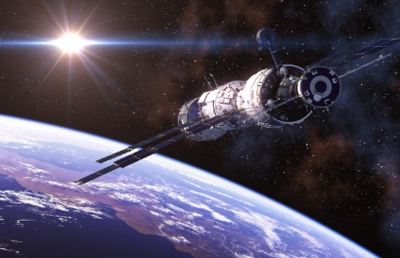
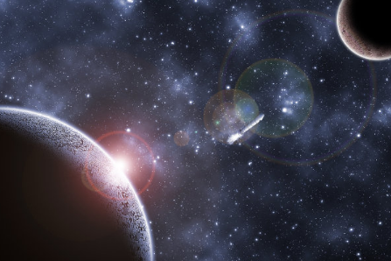
Responsive Design
Works across desktop, tablet, and mobile
Relative units (vw, vh) for scaling
Flexible layout with absolute positioning

Slide 9
Key Features
Skills Demonstrated
CSS Animations, Transforms, and Transitions
Custom gradients and visual layering
Clean semantic HTML structuring
Responsive design with CSS units
Motion design and visual storytelling
Creative coding without JavaScript

Slide 10
Use Cases
Frontend development portfolios
Educational astronomy visualizations
CSS-based motion design experiments
Creative coding projects
UI/UX simulation and storytelling
Inspiration for frontend animation enthusiasts

Slide 11

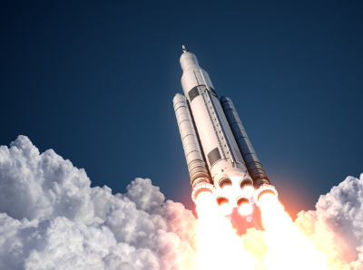

Project Takeaways
Showcases potential of HTML + CSS
Demonstrates motion design without JavaScript
Highlights creativity in frontend development

Slide 12
Future Enhancements
Add interactivity with optional JavaScript
Introduce more planets and satellites
Experiment with CSS 3D perspective effects

Slide 13
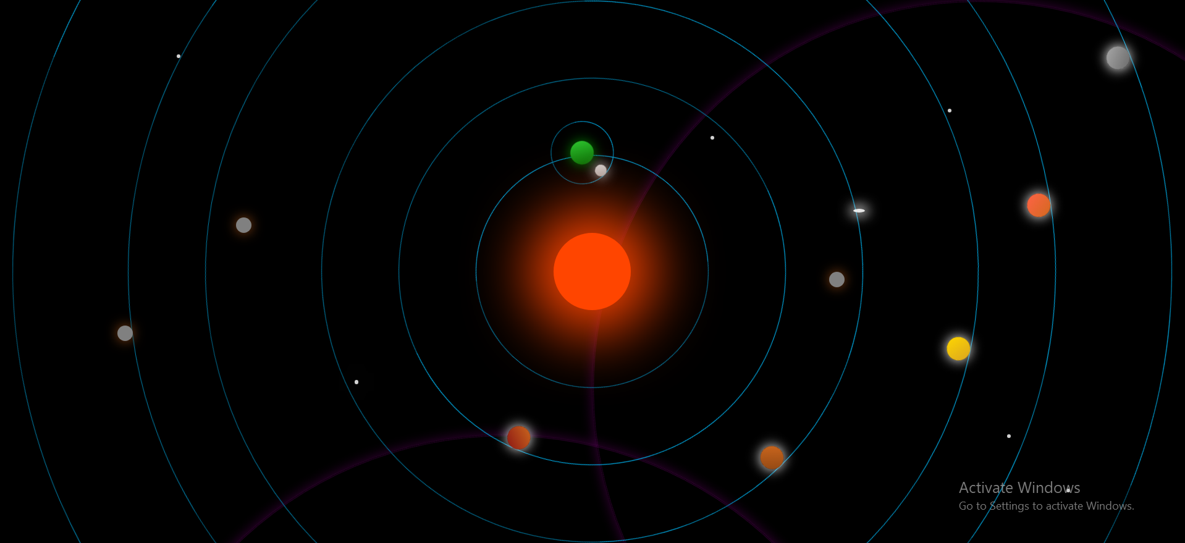
Project Overview

Slide 14



Thank You
Explore the project live in browser
Perfect blend of creativity and code
HTML + CSS can simulate entire universes

Slide 15
Thank You!
Every great presentation is complete with a great audience — and that’s you!

